Slide 1
Models & materials
DEV4 day4

Slide 2
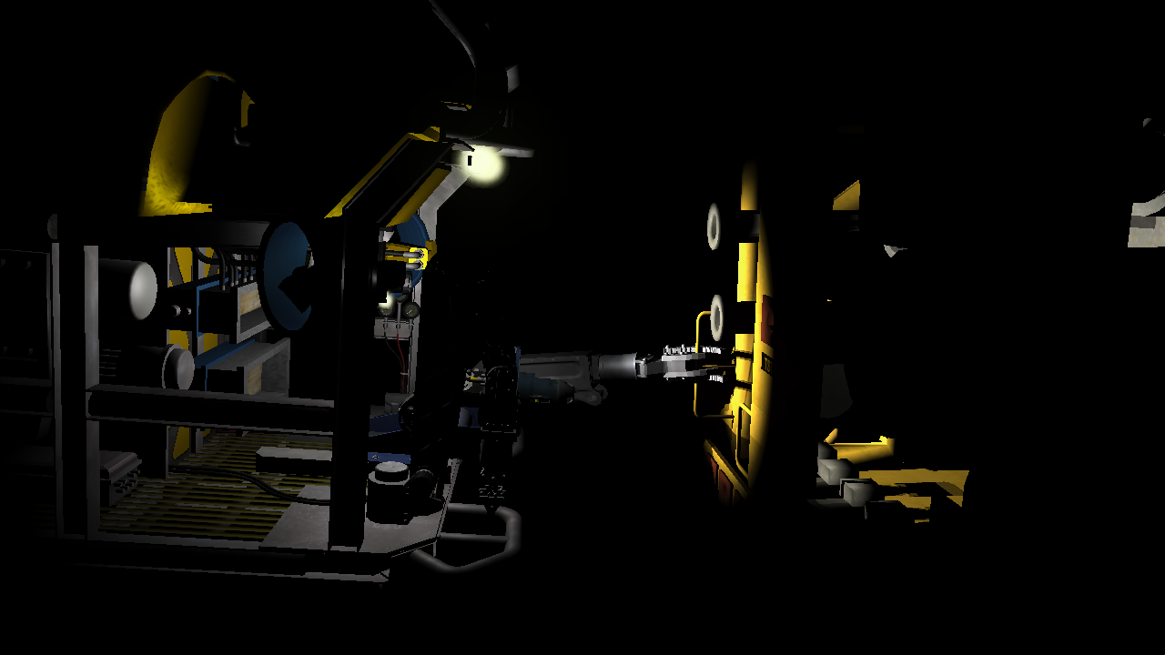
Lighting review

Slide 3
LIGHTING: REQUIRMENTS
Number of Lights?
Looping over multiple lights per-pixel can become very expensive. (suggest 8-16)
Cap the maximum active lights in the shader and/or apply the most relevant lights only.
Types of Lights?
POINT, SPOT, DIRECTIONAL
Light Attributes?
COLOR/BRIGHTNESS, DIRECTION, POSITION, AMBIENCE, CONE DIRECTION, CONE ANGLES, RADIUS
Vertex Normals (from model or procedurally generated)
Optional(but recommended) Items:
Vertex Tangents, Normal Map, Specular/Roughness Map, Metal Map, Environment Map

Slide 4
LIGHTING: EXECUTION
Adjust your vertex format to support normal vectors and (optional) tangents.
Transform these vectors from local to world space before sending to the pixel shader.
Load the relevant lighting attribute data onto the card as Uniform data.
Your pixel shader should have direct access to read this data.
Create a pixel shader that does the following for each light:
Compute direct light energy based on light type and surface normal/position
Compute indirect light from ambient light attribute (attenuated if point/spot)
Compute reflected light using eye-to-surface incidence vector (HLSL: reflect)
Use the current Mesh’s material attributes to adjust the formula below:
return saturate(totalDirect + totalIndirect) * diffuse + totalReflected + emissive

Slide 5
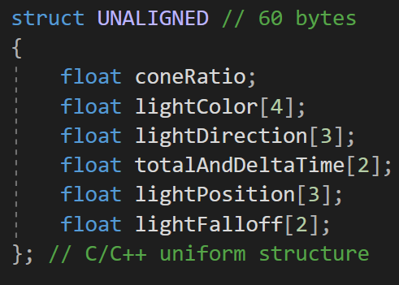
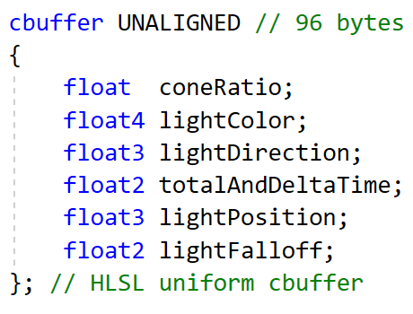
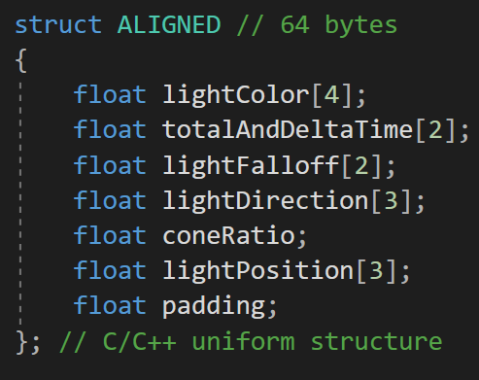
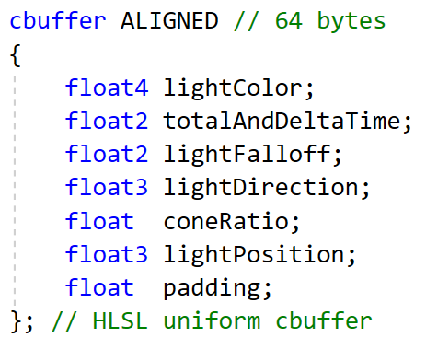
CPU to GPU UNIFORM byte ALIGNMENT ISSUES
Structures created in C/C++ typically have a 4- or 8-byte variable alignment unless otherwise specified. (32bit or 64bit)
When recreating these structures in GPU languages like HLSL/GLSL this can be a problem since the standard byte alignment is based on 16-byte registers. (128bit SIMD)
If you don’t take this into account, it can quickly result in byte differences between the two structures due to hidden padding.
This primarily impacts structs used for uniform data not Vertex data as that is designed to be tightly compacted.

Slide 6
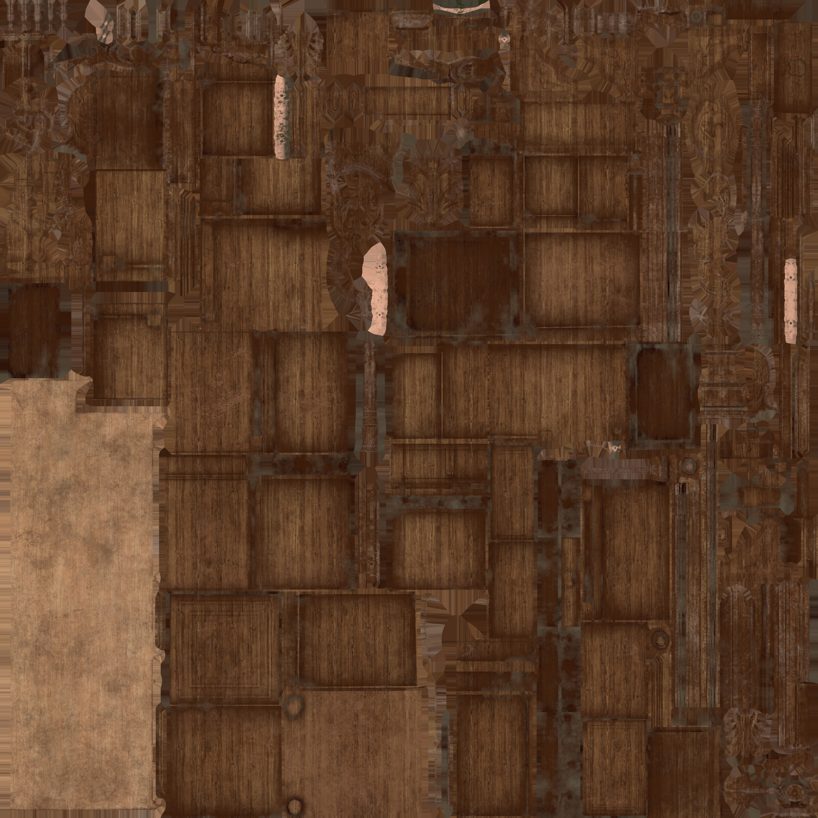
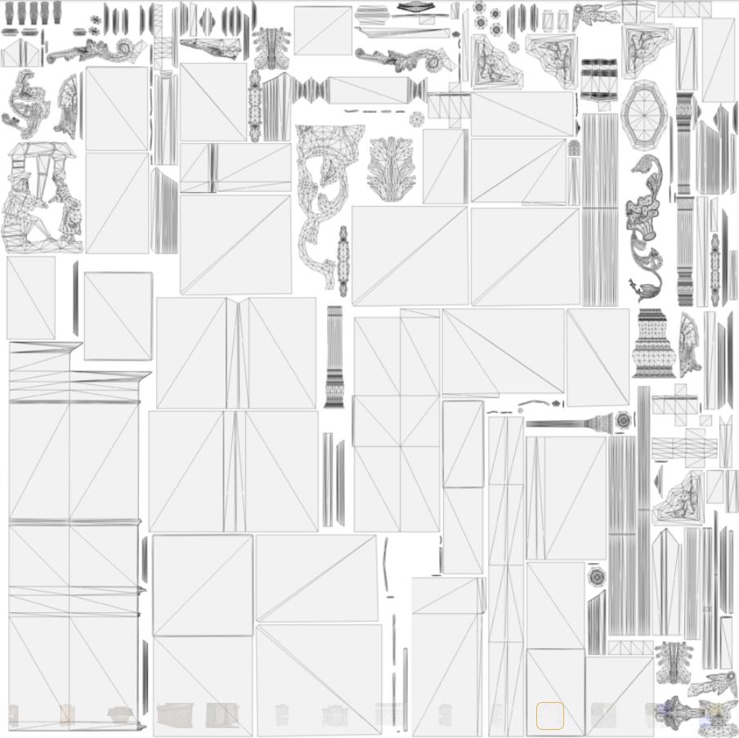
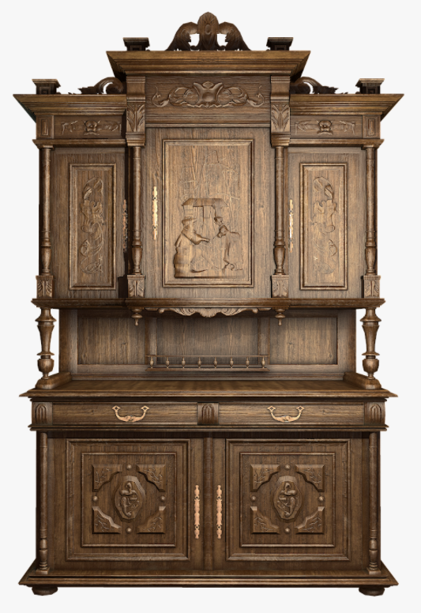
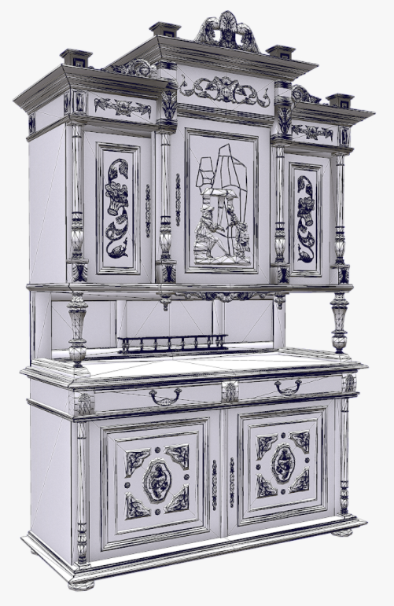

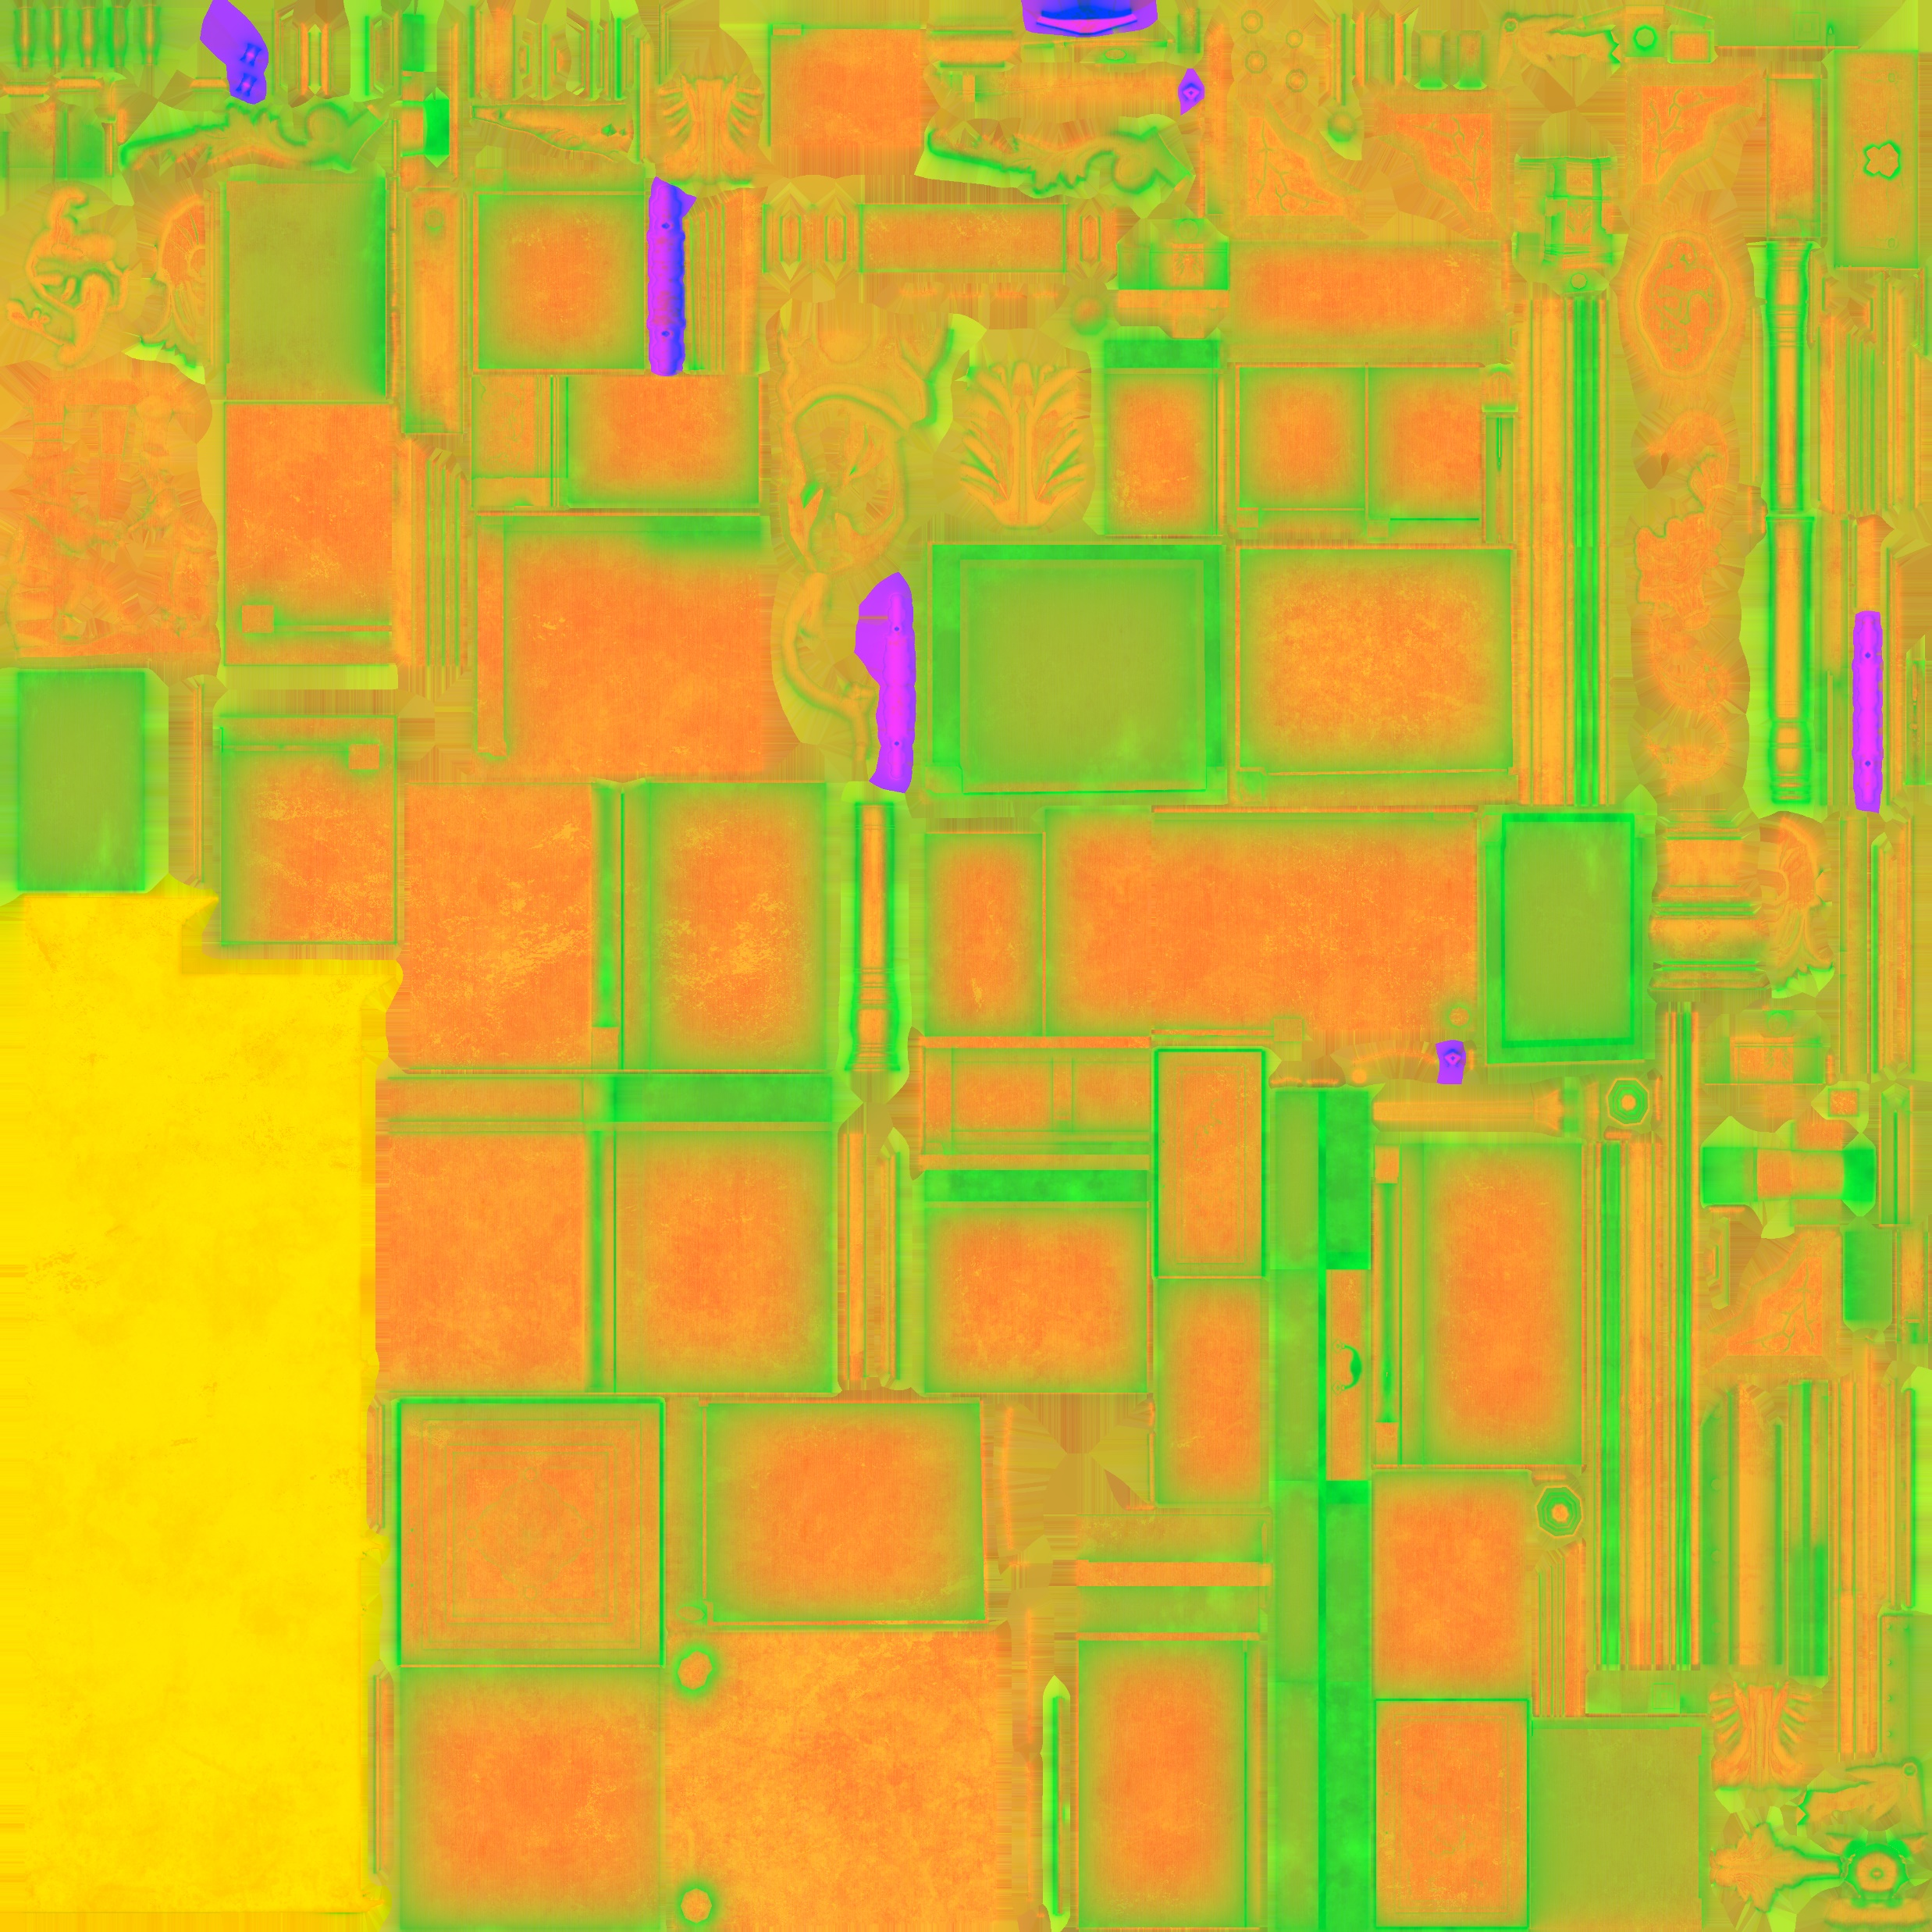

3D Model formats
UV UNWRAP
ALBEDO MAP
NORMAL MAP
ENGINE SPECIFIC MAP

Slide 7
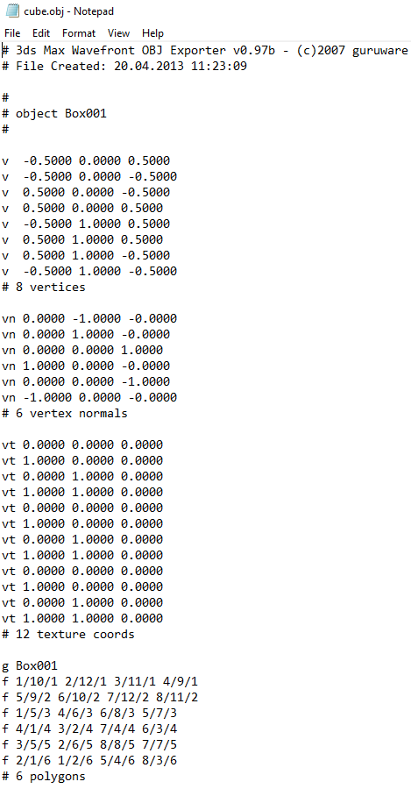
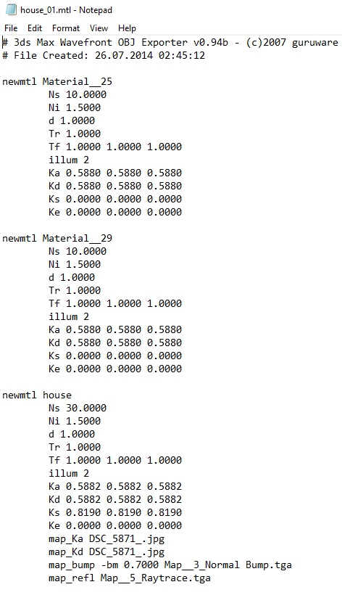
WAVEFRONT OBJECT (*.obj)
PROS:
Ubiquitous, Simple text-based format.
Uncomplicated flattened mesh hierarchy.
Great for learning, supports materials.
CONS:
Ancient format, missing lots of features.
No matrix data, No animation data.
You must Triangulate N-Sided polygons. ☹
Only supports classic materials not modern PBR style materials.

Slide 8
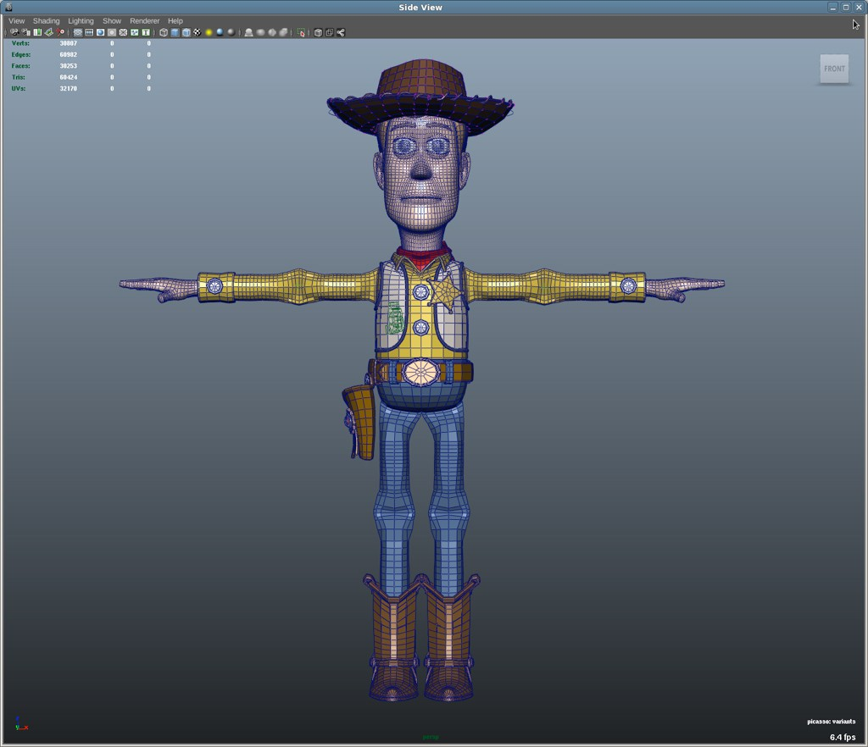
Filmbox (*.fbx)
PROS:
A 3D modeling standard, designed by Autodesk for all their various software.
Comes with its own loading SDK.
Has most everything you could want: Hierarchies, Animations, even Lights & Cameras.
CONS:
Excessively verbose and complex for direct use in real-time rendering.
Not simple, even with an SDK expect a steep learning curve.

Slide 9
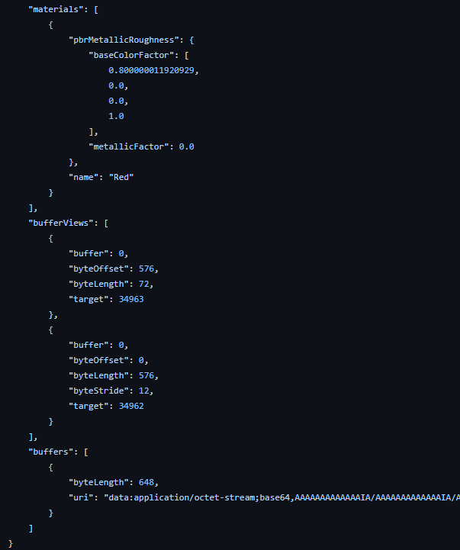
Graphics Language Transmission Format (*.gltf)
PROS:
Ultra modern format. (v2.0 in 2017)
Optimized for real-time rendering.
Supports modern PBR materials.
Supports transforms and animations.
Has a binary variant for faster loading.
CONS:
Not quite as widely supported as older formats. (growing quickly though)
Arguably more complex than an OBJ file.

Slide 10
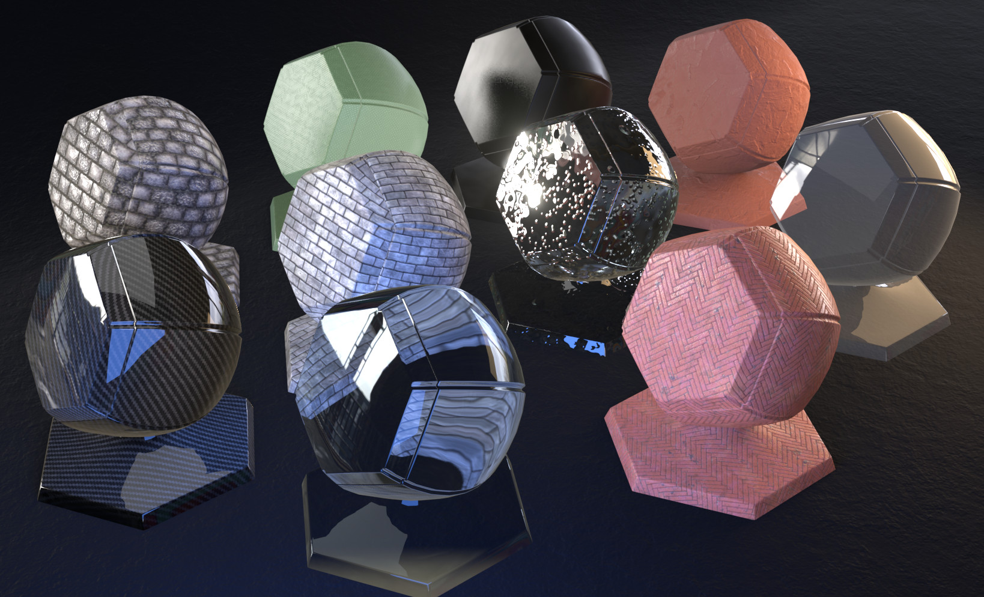
SURFACE materials

Slide 11
CLASSIC MATERIALS
Designed to tune/tweak the classic shading formulas we discussed earlier.
Examples: Specular Exponent & Intensity, Diffuse, Ambient, Specular and Emissive Color.
Unlike modern materials, these need to be hand tweaked by artists depending on a given lighting environment to look physically correct.
The major benefit is that these algorithms are easy to understand and very cheap to run on pretty much any 3D hardware. (low power mobile devices included)
Most games have moved to PBR based materials and workflows, but classic shading algorithms may still be relevant when performance is limited or PBR is overkill for a particular visual style.

Slide 12
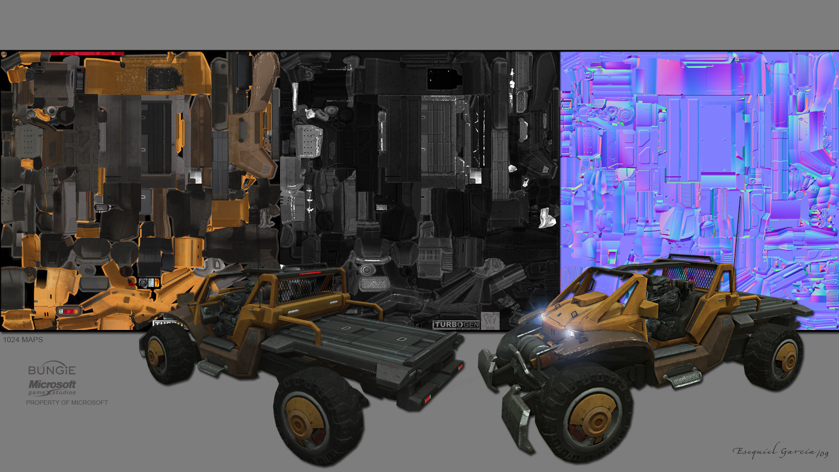
USING CLASSIC MATERIALS
A model file will contain a list of materials attributes to be used by each sub-mesh of the model.
Though art programs support multiple illumination models, games typically just use one. (some attributes are ignored)
Most non-PBR game-ready models will also come with diffuse, normal & specular/reflection textures as well.
We use these in the pixel shader to further tune the lighting for each pixel.

Slide 13
MODERN MATERIALS (PBR)
Uses significantly more physically accurate mathematics. Focuses on energy conservation, image based lighting and accurate Fresnel edge reflections.
Direct light shapes are the same as classic, but environment light & reflections are often read from a specially prepared cube map with light energy encoded. (optional)
Because the formulas are better at mimicking actual light behavior on surfaces, little to no hand tuning is required. (Artists instead describe the physical properties of surfaces)
A PBR shader is significantly more theoretically complex and expensive to run than a classic shader, however the visual improvement is significant.
Most PBR data comes in the form of textures not model file attributes. (per-pixel materials)

Slide 14
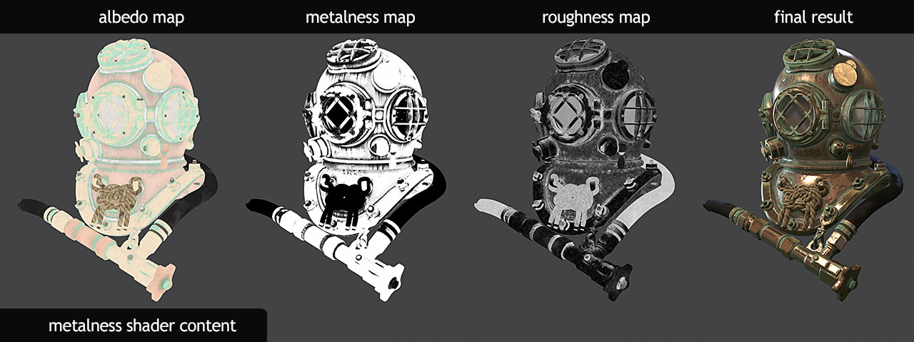
USING Modern MATERIALS
Materials overall are simpler:
Albedo HDR, Roughness 0-1, Metallic T/F
Typically, these materials need only be provided in texture form since no hand tuning is required.
Most PBR game-ready models will have a normal map and a combination of texture data to represent the 3 attributes.
We use these 3 attributes (along with an environment lighting map) in the pixel shader as arguments to the PBR formulas.

Slide 15
Game Rendering: Tools and resources
Model loading
Texture loading
PBR workflow
TinyGLTF
Open Asset Import Library
PVRTexTool
KTX Texture Library
PBR Example Shaders
Materialize

Slide 16
Q

